Slide 1
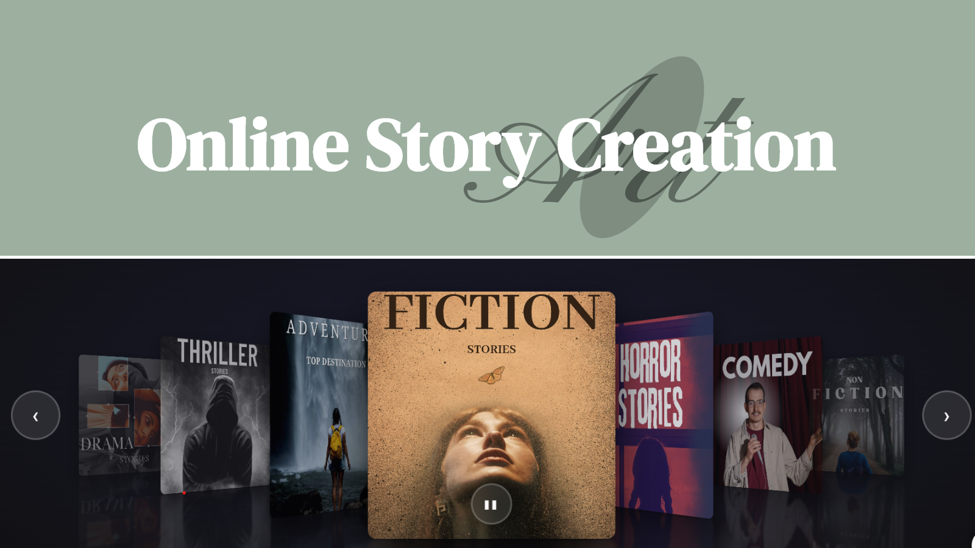

Slide 2







INTRODUCTION
The Online Story Platform is a web app for readers, authors, and admins.
Tech Stack:
Flask (Python)
HTML, CSS,Bootstrap, JavaScript
SQL-based

Slide 3




Role-Based Objectives
The platform defines clear objectives for each role - Readers, Authors, and Admins. This ensures a structured, engaging, and well-managed storytelling environment.
Authors
Readers
Community Users
Administrators
"Create, publish, and monetize stories with powerful tools, reader feedback, and monetization options."
"Discover stories, personalize reading, save favorites, and join community discussions."
"Join forums, take writing challenges, and collaborate in a vibrant creative community."
"Ensure quality and safety with moderation tools, community analytics, and user support."

Slide 4
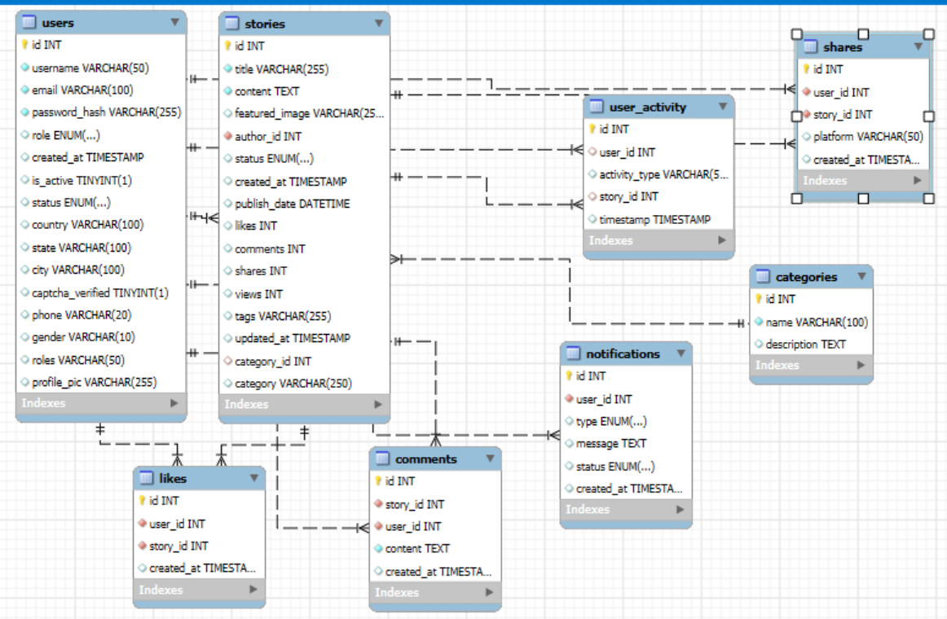
DATABASE DESIGN & ER MODEL

Slide 5
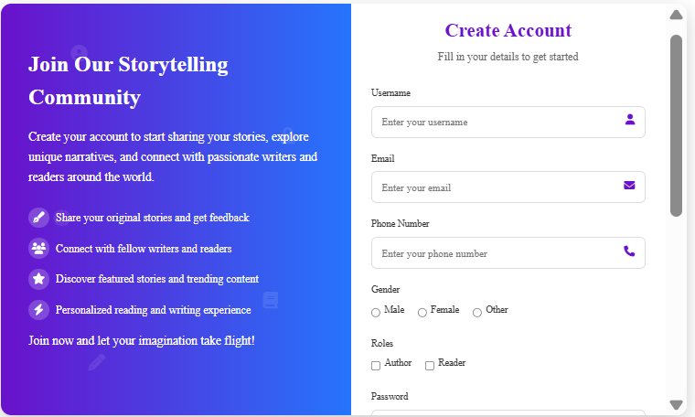
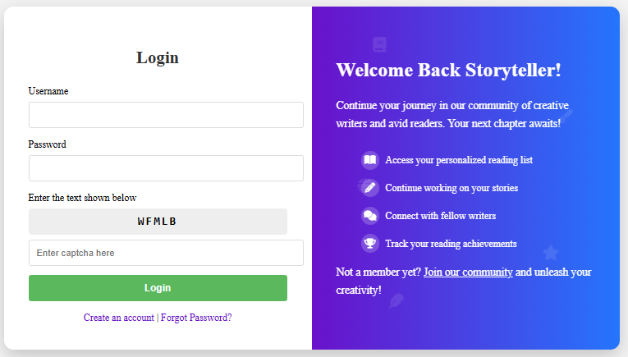
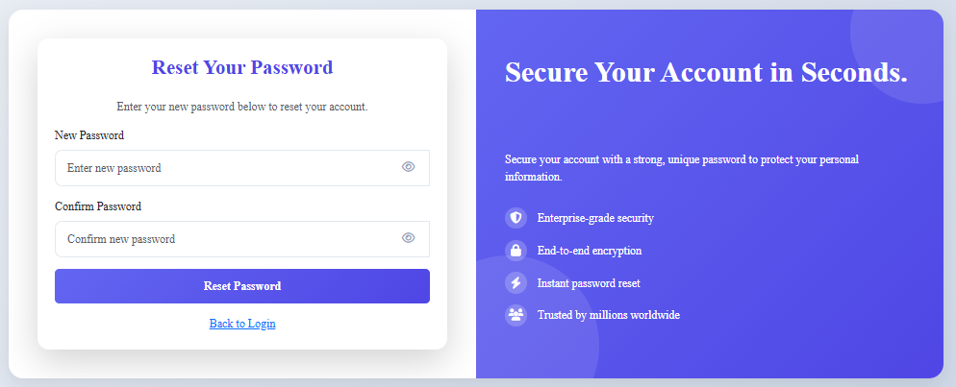
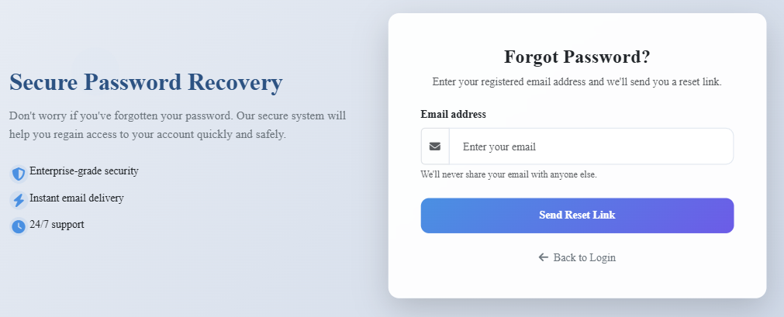
LOGIN & REGISTRATION FLOW

Slide 6


